Slide 1
Association Analysis
Data Mining and Data Warehousing

Slide 2
Scenario
Suppose you are a manager in a supermarket. You have thousands of transaction records. Each transaction contains items purchased together by a customer.
The question is: Can we discover patterns in customer purchasing behaviour?
Which items are frequently bought together?

Slide 3
Association Analysis
Association rule analysis is a data mining technique used to discover relationships or associations among items in large datasets.
The discovered relationships between items are called association rules.
Association rules help identify patterns of co-occurrence, meaning which items are frequently purchased or used together.
When to mine association rules?
Scenario:
You are a sales manager
Customer bought a pc and a digital camera recently
What should you recommend to her next?
Association rules are helpful in making your recommendation.
Milk → Bread

Slide 4
Contd…
How do we know which rules are meaningful?
Frequent patterns (item sets):
Frequent patterns are patterns that appear frequently in a dataset.
Transaction Database Example
In a market basket dataset, the itemset {milk, bread} may appear frequently in many transactions.
Therefore, {milk, bread} is considered a frequent itemset.
Sequential Pattern Example
In a shopping history database, customers may frequently purchase:
PC → Digital Camera → Memory Card
This sequence represents a frequent sequential pattern.

Slide 5
Frequent pattern mining
Frequent pattern mining is the task of discovering all itemsets that occur frequently in a dataset.
Frequent pattern mining for the discovery of interesting associations between item sets
Such associations can be applicable in many business decision making processes such as:
Catalog design
Market Basket analysis
Cross-marketing,
Sale campaign analysis,
Web log (click stream) analysis, etc

Slide 6
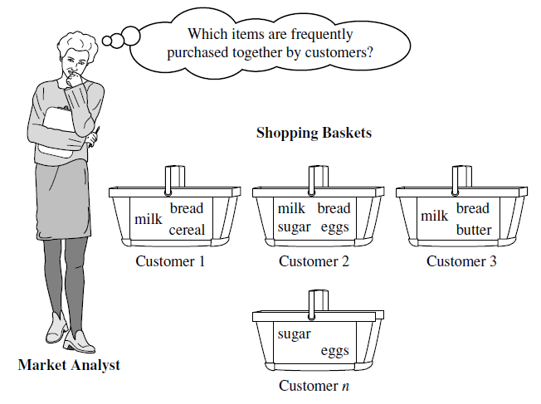
Market Basket analysis A typical example of frequent pattern(item set) mining for association rules.
Market basket analysis analyzes customer buying habits by finding associations between the different items that customers place in their shopping baskets.
Example of Association Rule:
milk → bread
Applications: To make marketing strategies

Slide 7
Definition: Frequent Itemset
Itemset
A collection of one or more items
Example: {Milk, Bread, Diaper}
k-itemset
An itemset that contains k items
Support count (σ)
Frequency of occurrence of an itemset
E.g. σ({Milk, Bread, Diaper}) = 2
Support
Fraction of transactions that contain an itemset
E.g. s({Milk, Bread, Diaper}) = 2/5
Frequent Itemset
An itemset whose support is greater than or equal to a minsup threshold

Slide 8
Definition: Association Rule
Association Rule :
An implication expression of the form X → Y, where X and Y are itemsets
e.g.,
It is not very difficult to develop algorithms that will find this associations in a large database.
The problem is that such an algorithm will also uncover many other associations that are of very little value.
It is necessary to introduce some measures to distinguish interesting associations from non-interesting ones.

Slide 9
Definition: Association Rule
Rule Evaluation Metrics
Support (s)
Fraction of transactions that contain both X and Y
Alternatively, support, s, probability that a transaction contains {X ∪ Y}
Confidence (c)
Measures how often items in Y appear in transactions that contain X
Alternatively, confidence, c, conditional probability that a transaction having X also contains Y
Example:

Slide 10
Example1
TID date items_bought
100 10/10/99 {F,A,D,B}
200 15/10/99 {D,A,C,E,B}
300 19/10/99 {C,A,B,E}
400 20/10/99 {B,A,D}
What is the support and confidence of the rule: {B,D} ⇒ {A}
Support:
percentage of tuples that contain {A,B,D} =
75%
Confidence:
100%

Slide 11
Example2
Given data set D is:
What is the support and confidence of the rule:
A ⇒ C
C ⇒ A
For rule A ⇒ C
Support =50% and
Confidence = 66.6%
For rule C ⇒ A
Support=50% and
Confidence = 100%

Slide 12
Association Rule Mining Task
Given a set of transactions T, the goal of association rule mining is to find all rules having
support ≥ minsup threshold
confidence ≥ minconf threshold
Brute-force approach:
List all possible association rules
Compute the support and confidence for each rule
Prune rules that fail the minsup and minconf thresholds
⇒ Computationally prohibitive!

Slide 13
Mining Association Rules
Example of Rules:
{Milk,Diaper} → {Beer} (s=0.4, c=0.67) {Milk,Beer} → {Diaper} (s=0.4, c=1.0)
{Diaper,Beer} → {Milk} (s=0.4, c=0.67)
{Beer} → {Milk,Diaper} (s=0.4, c=0.67) {Diaper} → {Milk,Beer} (s=0.4, c=0.5)
{Milk} → {Diaper,Beer} (s=0.4, c=0.5)
Observations:
All the above rules are binary partitions of the same itemset: {Milk, Diaper, Beer}
Rules originating from the same itemset have identical support but can have different confidence
Thus, we may decouple the support and confidence requirements

Slide 14
Mining Association Rules
Two-step approach:
Frequent Itemset Generation
Generate all itemsets whose support ≥ minsup
Rule Generation
Generate high confidence rules from each frequent itemset, where each rule is a binary partitioning of a frequent itemset.
Binary portioning example
X → Y : {milk,bread}→ {diaper}, {beer}→{milk, bread}, etc.
Frequent itemset generation is still computationally expensive!

Slide 15
Frequent Itemset Generation
Given d items, there are 2^{d} possible candidate itemsets

Slide 16
Reducing Number of Candidates
Apriori principle:
If an itemset is frequent, then all of its subsets must also be frequent
if {beer, diaper, nuts} is frequent, so is {beer, diaper}
Apriori principle holds due to the following property of the support measure:
Support of an itemset never exceeds the support of its subsets

Slide 17
Example
s(Bread) > s(Bread, Beer)
s(Milk) > s(Bread, Milk)
s(Diaper, Beer) > s(Diaper, Beer, Coke)

Slide 18
Contd…
How is the apriori property used in the algorithm?
Apriori pruning principle: If there is any itemset which is infrequent, its superset should not be generated/tested!
Found to be Infrequent
Pruned supersets

Slide 19
Illustrating Apriori purning Principle
Items (1-itemsets)
Pairs (2-itemsets)
(No need to generate candidates involving Coke or Eggs)
Minimum Support = 3

Slide 20
The Apriori Algorithm (the general idea)
Initially, scan DB once to get candidate item set C₁ and find frequent 1-items from C₁and put them to L_{k} (k=1)
Use L_{k} to generate a collection of candidate itemsets C_{k+1} with size (k+1)
Scan the database to find which itemsets in C_{k+1} are frequent and put them into L_{k+1}
If L_{k+1} is not empty(i.e., terminate when no frequent or candidate set can be generated)
k=k+1
GOTO 2

Slide 21

Generating association rules from frequent itemsets
Generate strong association rules from frequent itemsets (where strong association rules satisfy both minimum support and minimum confidence) as follows:
The rules generated from frequent itemsets, each one automatically satisfies the minimum support.
Non-empty proper subset
Non-empty proper subset

Slide 22
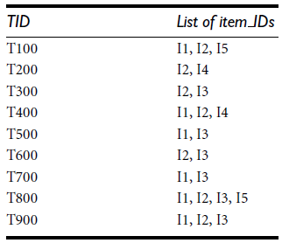
The Apriori Algorithm — Example1
Consider the following transactions for association rules analysis:
Use minimum support(min_sup) = 2 (2/9 = 22%) and
Minimum confidence = 70%

Slide 23
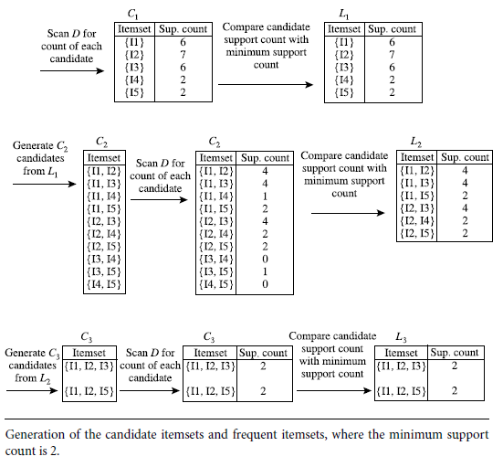
Contd…
Step1: Frequent Itemset Generation:

Slide 24
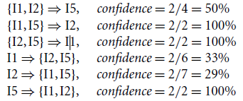
Contd…
Step2: Generating association rules: The data contain frequent itemset X ={I1,I2,I5} .What are the association rules that can be generated from X?
The proper nonempty subsets of X are
The resulting association rules are as shown below, each listed with its confidence:
Here, minimum confidence threshold is 70%, so only the second, third, and last rules are output, because these are the only ones generated that are strong.
I1,

Slide 25
The Apriori Algorithm—An Example 1
Sup_{min} = 2
Itemset | sup
{A} | 2
{B} | 3
{C} | 3
{D} | 1
{E} | 3
Database TDB
Itemset | sup
{A} | 2
{B} | 3
{C} | 3
{E} | 3
L₁
Tid | Items
10 | A, C, D
20 | B, C, E
30 | A, B, C, E
40 | B, E
C₁
1st scan
C₂
Itemset | sup
{A, B} | 1
{A, C} | 2
{A, E} | 1
{B, C} | 2
{B, E} | 3
{C, E} | 2
C₂
Itemset
{A, B}
{A, C}
{A, E}
{B, C}
{B, E}
{C, E}
L₂
Itemset | sup
{A, C} | 2
{B, C} | 2
{B, E} | 3
{C, E} | 2
2nd scan
C₃
Itemset
{B, C, E}
3rd scan
L₃
Itemset | sup
{B, C, E} | 2

Slide 26
The Apriori Algorithm — Example 2
Database D
min_sup=2=50%
L₁
C₁
Scan D
C₂
C₂
L₂
Scan D
C₃
Scan D
L₃

Slide 27
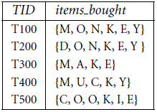
Homework
A database has five transactions. Let min sup = 60% and min conf = 80%.
Find all frequent itemsets using Apriori algorithm.
List all the strong association rules.

Slide 28
Problems with A-priori Algorithms
It is costly to handle a huge number of candidate sets.
For example if there are 10⁴ large 1-itemsets, the Apriori algorithm will need to generate more than 10⁷ candidate 2-itemsets. Moreover for 100-itemsets, it must generate more than 2¹⁰⁰ ≈ 10³⁰ candidates in total.
The candidate generation is the inherent cost of the Apriori Algorithms, no matter what implementation technique is applied.
To mine a large data sets for long patterns – this algorithm is NOT a good idea.
When Database is scanned to check C_{k} for creating L_{k}, a large number of transactions will be scanned even if they do not contain any k-itemset.

Slide 29
Frequent pattern growth (FP-growth):
A frequent pattern growth approach mines Frequent Patterns Without Candidate Generation.
In FP-Growth there are mainly two step involved:
Build a compact data structure called FP-Tree and
Then, extract frequent itemset directly from the FP-tree.

Slide 30
FP-tree Construction from a Transactional DB
FP-Tree is constructed using two passes over the data set:
Pass1:
Scan DB once, find frequent 1-itemsets (single item patterns)
Scan DB and find support for each item.
Discard infrequent items
Sort frequent items in descending order of their frequency(support count).
Sort the items in each transaction in descending order of their frequency. Use this order when building the FP-tree, so common prefixes can be shared.
Pass2: Scan DB again, construct FP-tree
FP-growth reads one transaction at a time and maps it to a path.
Fixed order is used, so path can overlap when transaction share items.
Pointers are maintained between nodes containing the same item(dotted line)

Slide 31
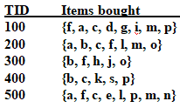
FP-tree Construction
Let transaction database D:
Let min_support = 3

Slide 32
FP-tree Construction
Pass 1: Finding frequent 1-itemset and sorting the this set in descending order of support count(frequency):
Item frequency
f 4
a 4
c 4
d 1
g 1
i 1
m 3
p 3
b 3
l 2
o 2
h 1
j 1
k 1
s 1
e 1
n 1

Slide 33
FP-tree Construction
Pass 1: Finding frequent 1-itemset and sorting the this set in descending order of support count(frequency):
Then, Making sorted frequent transactions in the transaction dataset D:
Item frequency
f 4
c 4
a 3
b 3
m 3
p 3
TID Items bought (ordered) frequent items
100 {f, a, c, d, g, i, m, p} {f, c, a, m, p}
200 {a, b, c, f, l, m, o} {f, c, a, b, m}
300 {b, f, h, j, o} {f, b}
400 {b, c, k, s, p} {c, b, p}
500 {a, f, c, e, l, p, m, n} {f, c, a, m, p}

Slide 34
FP-tree Construction
TID freq. Items bought
100 {f, c, a, m, p}
200 {f, c, a, b, m}
300 {f, b}
400 {c, b, p}
500 {f, c, a, m, p}
min_support = 3
Item frequency
f 4
c 4
a 3
b 3
m 3
p 3
root
f:1
c:1
a:1
m:1
p:1

Slide 35
FP-tree Construction
TID freq. Items bought
100 {f, c, a, m, p}
200 {f, c, a, b, m}
300 {f, b}
400 {c, b, p}
500 {f, c, a, m, p}
min_support = 3
Item frequency
f 4
c 4
a 3
b 3
m 3
p 3
root
f:2
c:2
a:2
m:1
b:1
p:1
m:1

Slide 36
FP-tree Construction
TID freq. Items bought
100 {f, c, a, m, p}
200 {f, c, a, b, m}
300 {f, b}
400 {c, b, p}
500 {f, c, a, m, p}
min_support = 3
Item frequency
f 4
c 4
a 3
b 3
m 3
p 3
root
f:3
c:2
b:1
a:2
m:1
b:1
p:1
m:1

Slide 37
FP-tree Construction
TID freq. Items bought
100 {f, c, a, m, p}
200 {f, c, a, b, m}
300 {f, b}
400 {c, b, p}
500 {f, c, a, m, p}
min_support = 3
Item frequency
f 4
c 4
a 3
b 3
m 3
p 3
root
f:3
c:1
c:2
b:1
b:1
a:2
p:1
m:1
b:1
p:1
m:1

Slide 38
FP-tree Construction
TID freq. Items bought
100 {f, c, a, m, p}
200 {f, c, a, b, m}
300 {f, b}
400 {c, b, p}
500 {f, c, a, m, p}
min_support = 3
Item frequency
f 4
c 4
a 3
b 3
m 3
p 3
root
Header Table
Item frequency head
f 4
c 4
a 3
b 3
m 3
p 3
f:4
c:1
c:3
b:1
b:1
a:3
p:1
m:2
b:1
p:2
m:1

Slide 39
FP-tree Construction
TID freq. Items bought
100 {f, c, a, m, p}
200 {f, c, a, b, m}
300 {f, b}
400 {c, b, p}
500 {f, c, a, m, p}
min_support = 3
Item frequency
f 4
c 4
a 3
b 3
m 3
p 3
root
Header Table
Item frequency head
f 4
c 4
a 3
b 3
m 3
p 3
f:4
c:1
c:3
b:1
b:1
a:3
p:1
Pointers are maintained between nodes containing the same item (dotted line)
m:2
b:1
p:2
m:1

Slide 40
Benefits of the FP-tree Structure
Completeness:
never breaks a long pattern of any transaction
preserves complete information for frequent pattern mining
Compactness
reduce irrelevant information—infrequent items are gone
frequency descending ordering: more frequent items are more likely to be shared
never be larger than the original database.

Slide 41
Mining Frequent Patterns Using FP-tree
The FP-tree is mined as follows:
Start from each frequent length-1 pattern (as an initial suffix pattern)
construct its conditional pattern base (a “sub-database,” which consists of the set of prefix paths in the FP-tree co-occurring with the suffix pattern)
then construct its (conditional) FP-tree, and perform mining recursively on such a tree.
The pattern growth is achieved by the concatenation of the suffix pattern with the frequent patterns generated from a conditional FP-tree.

Slide 42
Mining Frequent Patterns Using the FP-tree (cont’d)
Start with last item in order (i.e., p).
Follow node pointers and traverse only the paths containing p.
Accumulate all of transformed prefix paths of that item to form a conditional pattern base
Conditional pattern base for p
{(fcam:2), (cb:1)}
f:4
c:1
Count items in conditional base
(remove items with less than minimum support)
f = 2, c = 2+1=3, a = 2, m = 2, b = 2
c:3
b:1
a:3
p:1
{}
p

m:2
c:3

All frequent patterns that include p
cp
p:2
p’s-conditional FP-tree
(contains only path c:3)

Slide 43
Mining Frequent Patterns Using the FP-tree (cont’d)
Move to next least frequent item in order, i.e., m
Follow node pointers and traverse only the paths containing m.
Accumulate all of transformed prefix paths of that item to form a conditional pattern base
m’s conditional pattern base: {(fca:2), (fcab:1)}
Count items in conditional base
(remove items with less than minimum support)
f = 2+1=3, c = 2+1=3, a = 2+1=3, b = 2
f:4
c:3
{}
All frequent patterns that include m
fm, cm, am,
fcm, fam, cam,
fcam
m
a:3

f:3

m:2
b:1
c:3
m:1
a:3
m’s-conditional FP-tree
(contains only path fca:3)

Slide 44
Conditional Pattern-Bases for the example
Item
Conditional pattern-base
Conditional FP-tree
p
{(fcam:2), (cb:1)}
{(c:3)}|p
m
{(fca:2), (fcab:1)}
{(f:3, c:3, a:3)}|m
b
{(fca:1), (f:1), (c:1)}
Empty
a
{(fc:3)}
{(f:3, c:3)}|a
c
{(f:3)}
{(f:3)}|c
f
Empty
Empty

Slide 45
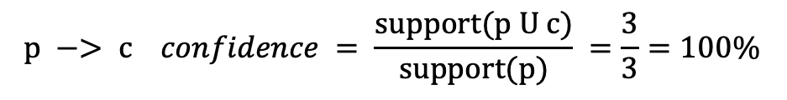
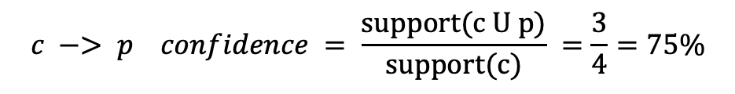
From the Conditional Frequent Pattern(FP) tree the Frequent Pattern rules are generated by pairing the items of the Conditional Frequent Pattern Tree set to the corresponding item as given in the below table.
Item | Frequent Patterns Generated
p | {<c,p:3>}
m | {<f,m:3>, <c,m:3>, <a,m:3>, <f,m:2>, <f,c,m:3>}, <f,a,m:3>, <c,a,m:3>, <f,c,a,m:3>
b | Empty
a | {<f,a:3>, <c,a:3>, <f,c,a:3>}
c | <f,c:3>
f | Empty
min_support = 3
Rules from row 1:
Item frequency
f 4
c 4
a 3
b 3
m 3
p 3
c -> p
p -> c
$$c −> p confidence = \frac{support(c U p)}{support(c)} =\frac{3}{4}=75\%$$
$$p −> c confidence = \frac{support(p U c)}{support(p)} =\frac{3}{3}=100\%$$
Now if confidence is 90% then rule c->p will be rejected and only the rule p->c will be considered

Slide 46
From the Conditional Frequent Pattern(FP) tree the Frequent Pattern rules are generated by pairing the items of the Conditional Frequent Pattern Tree set to the corresponding to the item as given in the below table.
Item | Frequent Patterns Generated
p | {<c,p:3>}
m | {<f,m:3>, <c,m:3>, <a,m:3>, <f,m:2>, <f,c,m:3>}, <f,a,m:3>, <c,a,m:3>, <f,c,a,m:3>
b | Empty
a | {<f,a:3>, <c,a:3>, <f,c,a:3>}
c | <f,c:3>
f | Empty
Rules from row 4:
min_support = 3
Item frequency
f 4
c 4
a 3
b 3
m 3
p 3
f -> a
a -> f
We can calculate it the same as done in the previous slide and select only those rules above the minimum confidence
c -> a
a -> c
{f, c} -> a
a -> {f, c}
{f, a} -> c
c -> {f, a}
{a, c} -> f
f -> {a, c}
{f, c} -> a
a -> {f, c}

Slide 47
Why Is Frequent Pattern Growth Fast?
Performance studies show
FP-growth is faster than Apriori, and is also scalable
Reasoning
No candidate generation, no candidate test
Uses compact data structure
Eliminates repeated database scan
Basic operation is counting and FP-tree building

